Slide 1

Oracle: SQL
Selected Single-Row Functions

Slide 2
Objectives
Use the UPPER, LOWER, and INITCAP functions to change the case of field values and character strings
Manipulate character substrings with the SUBSTR and INSTR functions
Nest functions inside other functions
Determine the length of a character string using the LENGTH function
Use the LPAD and RPAD functions to pad a string to a certain width
Use the LTRIM and RTRIM functions to remove specific characters strings
Substitute character string values with the REPLACE
Oracle 11g: SQL

Slide 3
Objectives (continued)
Round and truncate numeric data using the ROUND
Return the remainder only of a division operation using the MOD function
Use the ABS function to set numeric values as positive
Calculate the number of months between two dates using the MONTHS_BETWEEN function
Manipulate date data using the ADD_MONTHS, NEXT_DAY, LAST_DAY, and TO_DATE functions
Oracle 11g: SQL

Slide 4
Objectives (continued)
Using the NVL function
Display dates and numbers in a specific format with the TO_CHAR function
Oracle 11g: SQL

Slide 5
Terminology
Function – predefined block of code that accepts arguments
Single-row function – returns one row of results for each record processed
Multiple-row function – returns one result per group of data processed (covered in the next chapter)
Oracle 11g: SQL

Slide 6
Case Conversion Functions
Case conversion functions alter the case of data stored in a column or character string
  Used in a SELECT clause, they alter the appearance of the data in the results
  Used in a WHERE clause, they alter the value for comparison
Oracle 11g: SQL

Slide 7
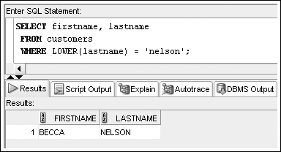
LOWER Function
Used to convert characters to lowercase letters
Oracle 11g: SQL

Slide 8
UPPER Function
Used to convert characters to uppercase letters
It can be used in the same way as the LOWER function
  To affect the display of characters, it is used in a SELECT clause
  To modify the case of characters for a search condition, it is used in a WHERE clause
The syntax for the UPPER function is UPPER(c)
  Where c is the character string or field to be converted into uppercase characters
Oracle 11g: SQL

Slide 9

INITCAP Function
Used to convert characters to mixed case
Oracle 11g: SQL

Slide 10
Character Manipulation Functions
Character manipulation functions manipulate data by extracting substrings, counting the number of characters, replacing strings, etc.
Oracle 11g: SQL

Slide 11
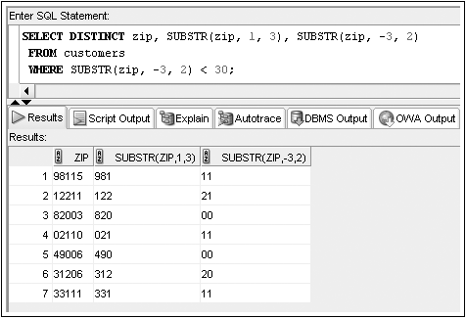
SUBSTR Function
Used to return a substring, or portion of a string
Oracle 11g: SQL

Slide 12
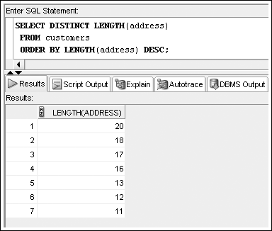
LENGTH Function
Used to determine the number of characters in a string
Oracle 11g: SQL

Slide 13
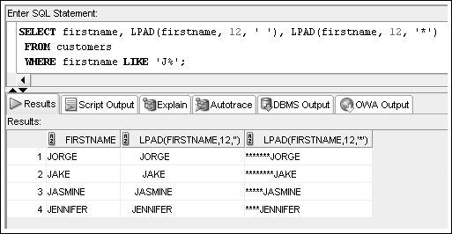
LPAD and RPAD Functions
Used to pad, or fill in, a character string to a fixed width
Oracle 11g: SQL

Slide 14
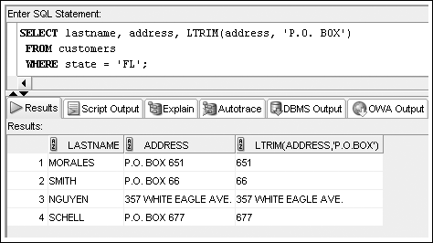
LTRIM and RTRIM Functions
Used to remove a specific string of characters
Oracle 11g: SQL

Slide 15
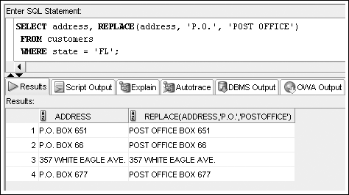
REPLACE Function
Substitutes a string with another specified string
Oracle 11g: SQL

Slide 16
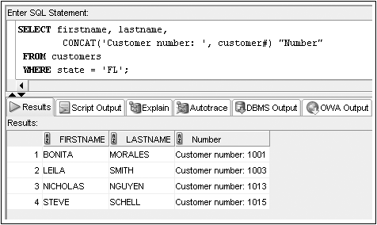
CONCAT Function
Used to concatenate two character strings
Oracle 11g: SQL

Slide 17
Number Functions
Allow for manipulation of numeric data
  ROUND
  MOD
  ABS
Oracle 11g: SQL

Slide 18

ROUND Function
Used to round numeric columns to a stated precision
Oracle 11g: SQL

Slide 19

MOD Function
Oracle 11g: SQL

Slide 20

ABS Function
Oracle 11g: SQL

Slide 21
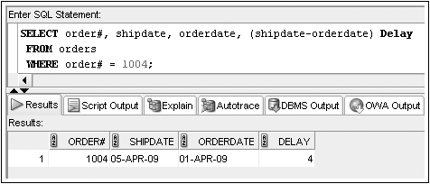
Date Functions
Used to perform date calculations or format date values
Subtract date for number of days difference
Oracle 11g: SQL

Slide 22
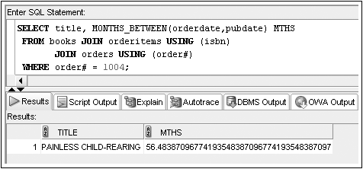
MONTHS_BETWEEN Function
Determines the number of months between two dates
Oracle 11g: SQL

Slide 23
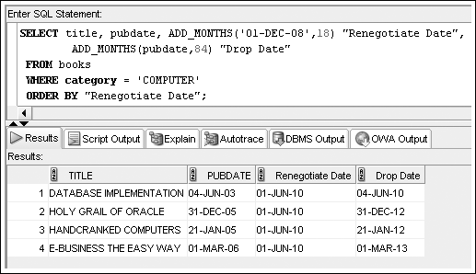
ADD_MONTHS Function
Adds a specified number of months to a date
Oracle 11g: SQL

Slide 24
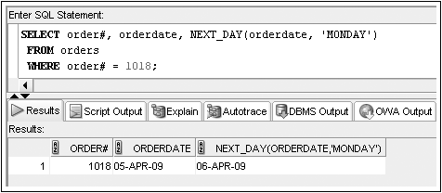
NEXT_DAY Function
Determines the next occurrence of a specified day of the week after a given date
Oracle 11g: SQL

Slide 25
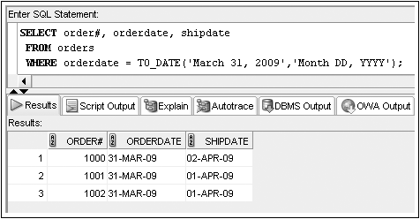
TO_DATE Function
Converts various date formats to the internal format (DD-MON-YY) used by Oracle 11g
Oracle 11g: SQL

Slide 26

NVL Function
Substitutes a value for a NULL value
Oracle 11g: SQL

Slide 27
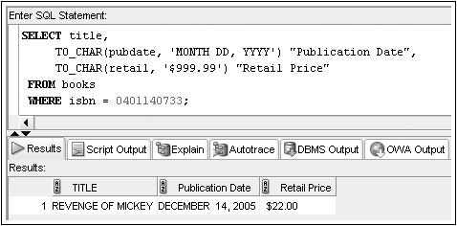
TO_CHAR Function
Converts dates and numbers to a formatted character string
Oracle 11g: SQL

Slide 28
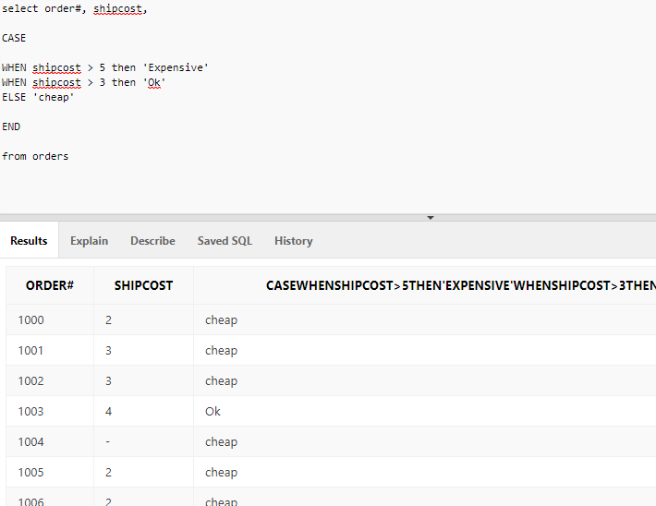
CASE Expression
Oracle 11g: SQL

